Slide 1
E-Farm : Farmer's, Distributor's - one stop solution
By
Team Name - Orbit Defenderz
Anita Prasad
Priya Sundaram
Afreen Mohammad
MS Jayaram
Naveen Saravanan

Slide 2
Overview:-
The era of modernization is viewed in the entire sectors especially in the agriculture sector. Gone are the days when farmers meant a poor man laboring hard to meet his needs. In the modern times, farmers are equipped with agriculture technology that is latest and trouble free.
With the entry and increasing influence of the science in the traditional farming, the agriculture industry of the nation is celebrating green revolution each moment. The new technologies have helped in utilizing even the small land into loads of profitmaking source. Farmers whether small or big are getting more and more aware of the fact that technology is very beneficial to them and the future of the agriculture industry.

Slide 3
Problems faced by Farmers
Less Use of modern technology.
Climate change
Poor soil which cause unhealthy in plant growth
Reaching customers is one of the most difficult parts of operating any business. Even experienced marketers have trouble conquering these challenges.

Slide 4
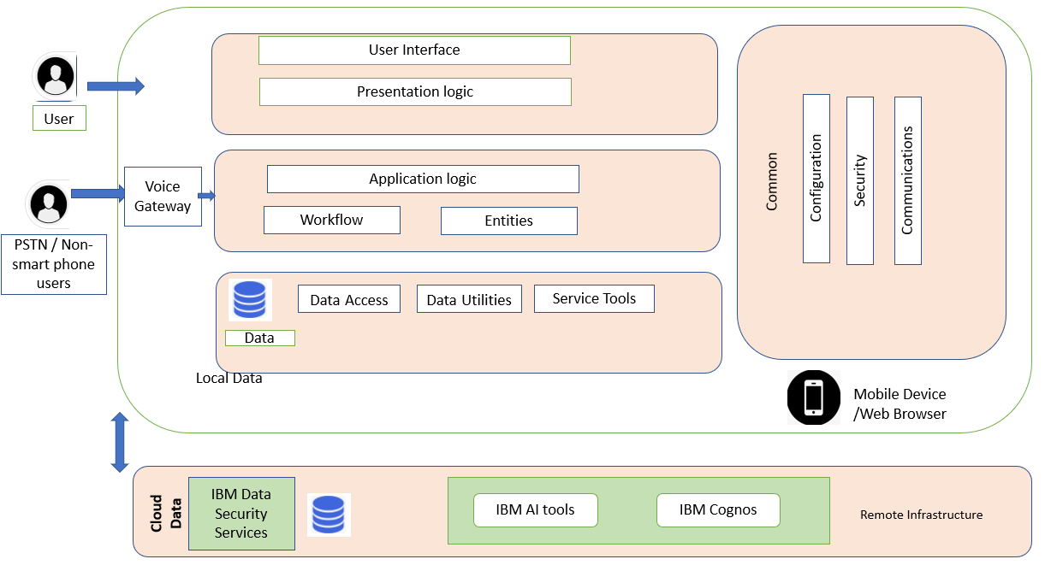
Architectural Diagram:-

Slide 5
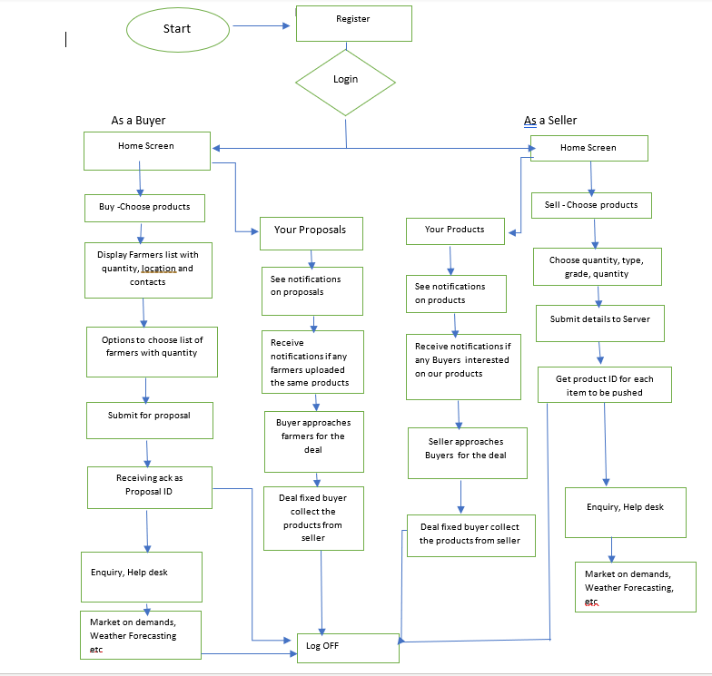
Flowchart:-

Slide 6
Flow Description:
Users who can utilize the E-farm application can create their account through registration process under the category of farmer(seller) or Distributor (buyer).
Farmer who does not have digital platform can dial in the PSTN Service call number to register himself and can promote their food products hence forth .Back-end support team will log the details of the products under his name and IDs .
Once the user logs in, say (a farmer) he can see the home page where in he can sell his products by SELL product tab .
Upon selecting the product category, user can select the item and can input quantity of the product which he is ready to sell.
Sale item ID will be generated once the user submits his sale .Like wise the user can submit multiple request for their other products
Once submitted they will receive a Proposal ID as acknowledgment
When buyers(distributors) submit their request, farmers receive a notification
Buyers can approach farmers with their request and fix the deal. Then buyers collect the requested product from the farmers
User can approach support system /service help desk for any enquiry on their orders

Slide 7
Technologies used worldwide for collecting real time data and processing
- IBM cognos analytics
- IBM Data Server Manager
- IBM Db2 Connect
- Cross-platform software
- Connecting to the Internet

Slide 8
Features Commonly used agricultural machinery “Tractor“
The most common use of the term "tractor" is for the vehicles used on farms. The farm tractor is used for pulling or pushing agricultural machinery or trailers, for plowing, tilling, disking, harrowing, planting, and similar tasks.
Specifically designed to deliver a high tractive effort (or torque) at slow speeds, for the purposes of hauling a trailer or machinery used in agriculture.
(e.g.) Uber for Tractor

Slide 9
GitHub repository Link:-
https://github.com/AnitaPrasadkk/efarm
Three-minute demo video Link:-
https://youtu.be/J378EG1eDJQ

Slide 10
Pros:-
1) Supply water according to the requirements of crop
2) Using modern technology, we can increase the soil fertility
3) Increasing the profit of farmer and reducing the cost operation
4) By adopting modern technology farmer change their sowing method from manual to mechanical
5) Tunnel forming is a basic perception for the production of the off-season vegetables
6) It is possible to grow crop in desert areas.

Slide 11
Cons:-
1) Due to lack of education farmer are unable to run the machine properly
2) It may lead to environmental hazard
3) No doubt, technology has some merits and demerits but if we can use it moderately, we can increase our production
3) Shortage of foreign exchange in poor countries. So, it becomes difficult to import the machinery.
4) The break down of the machinery will cause delay in agricultural operation.

Slide 12
Thank You

